Slide 1
Welcome to Robotics Club Week5 !
https://kanatpy.github.io/wses-robotics/
2026-05-15
Alp Marangoz

Slide 2

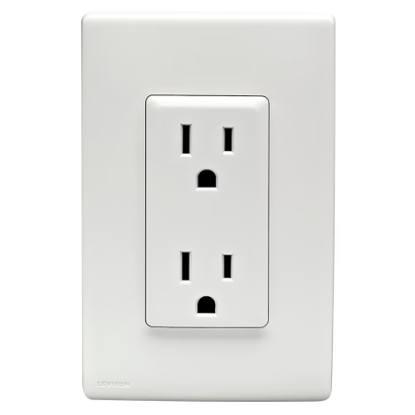
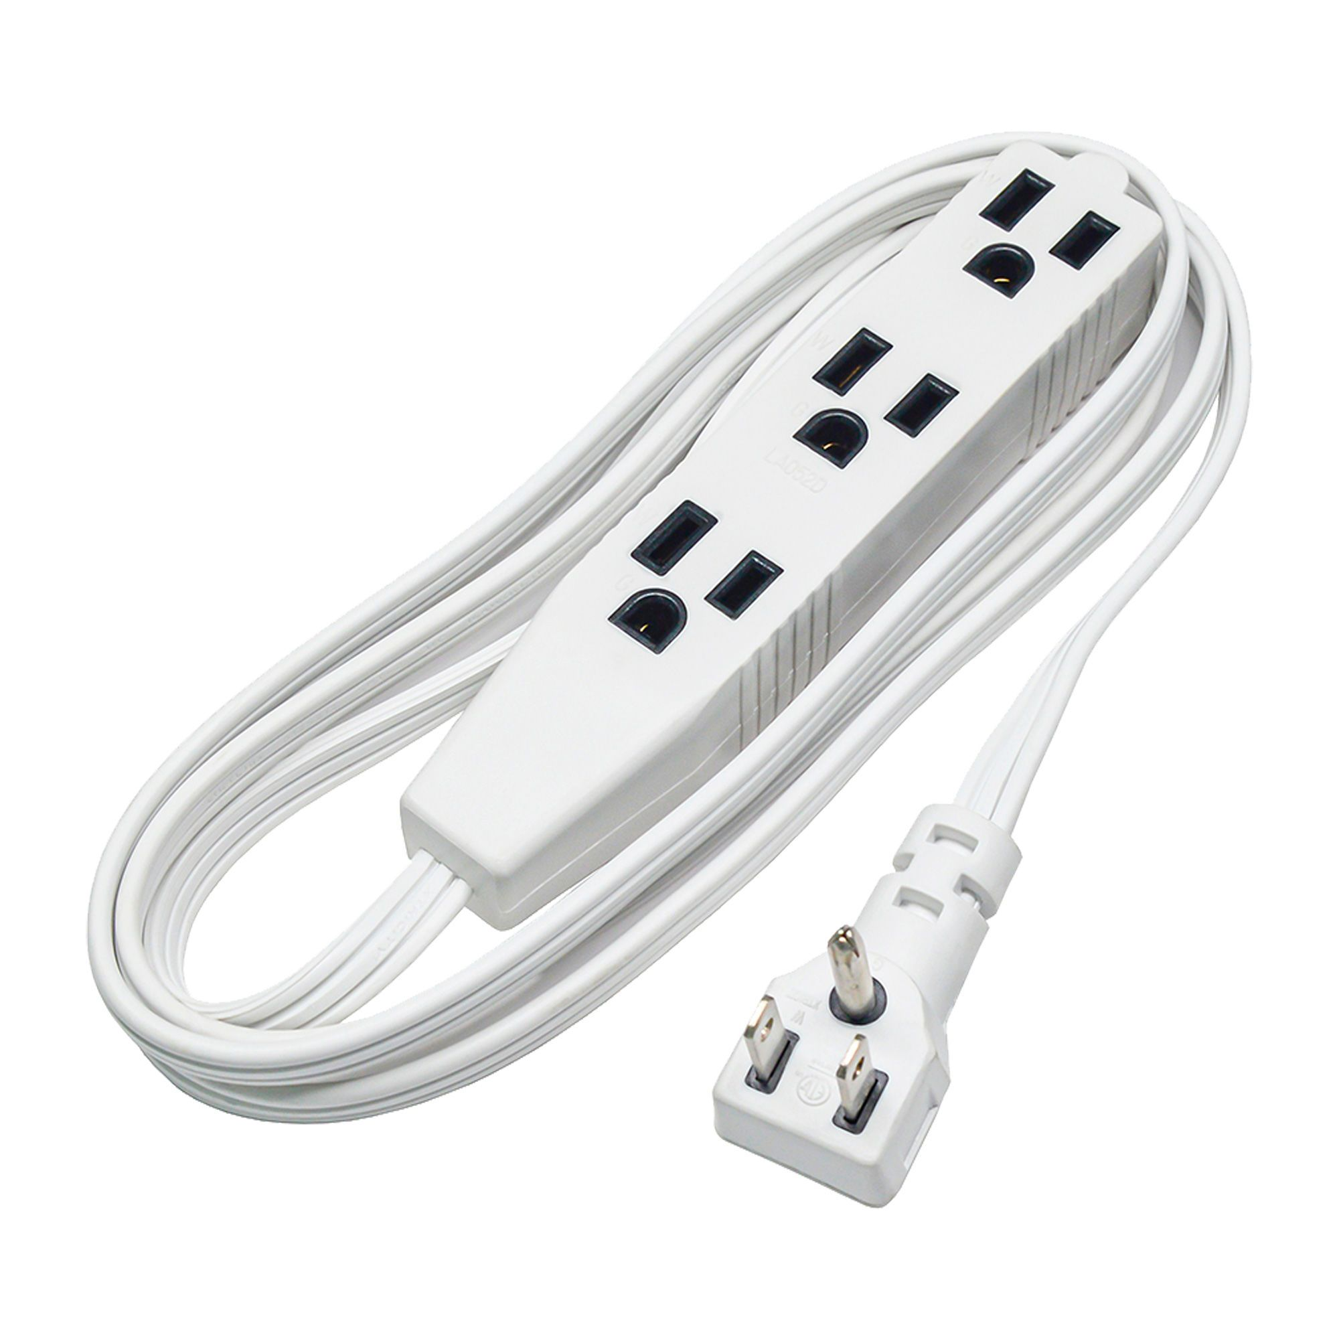

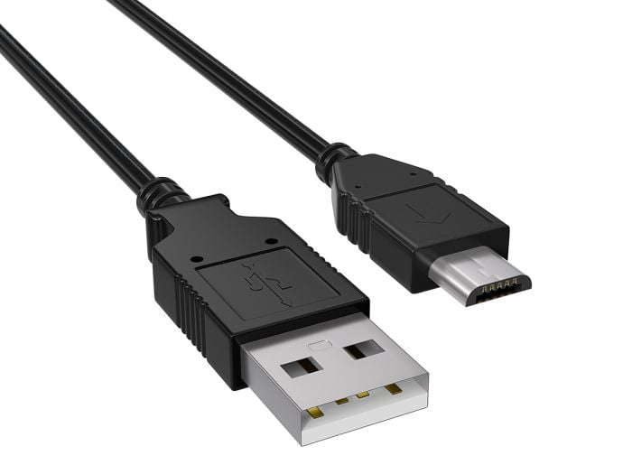

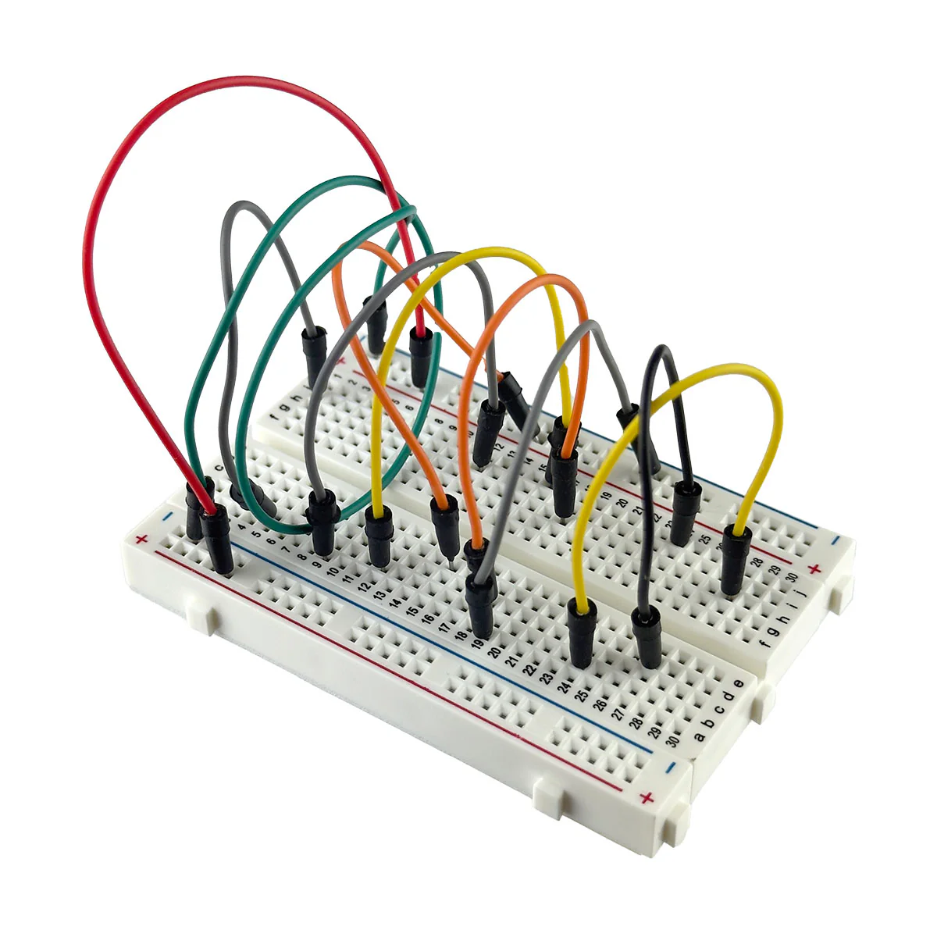
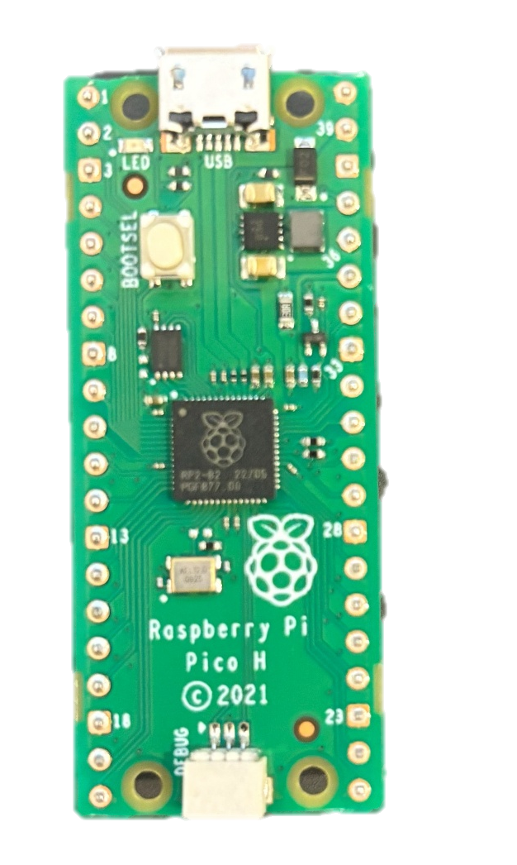
Safety!

Slide 3
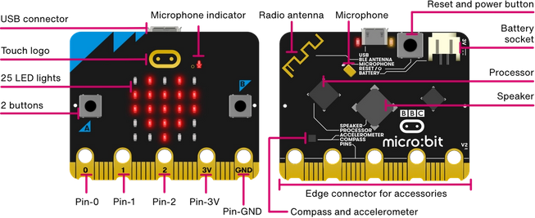
https://microbit.org/get-started/features/overview/

Slide 4
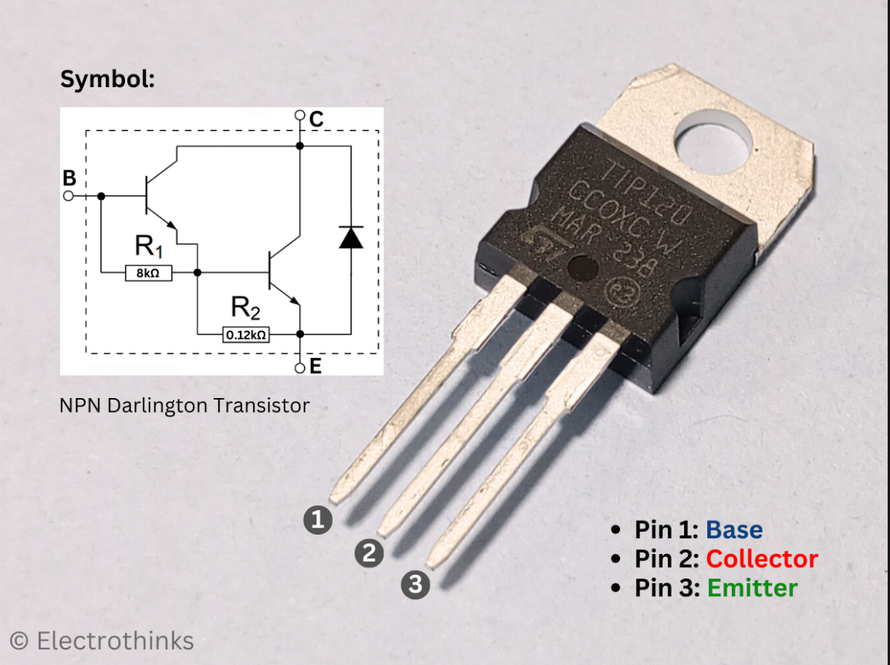
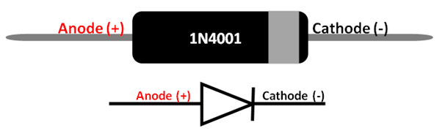

Slide 5
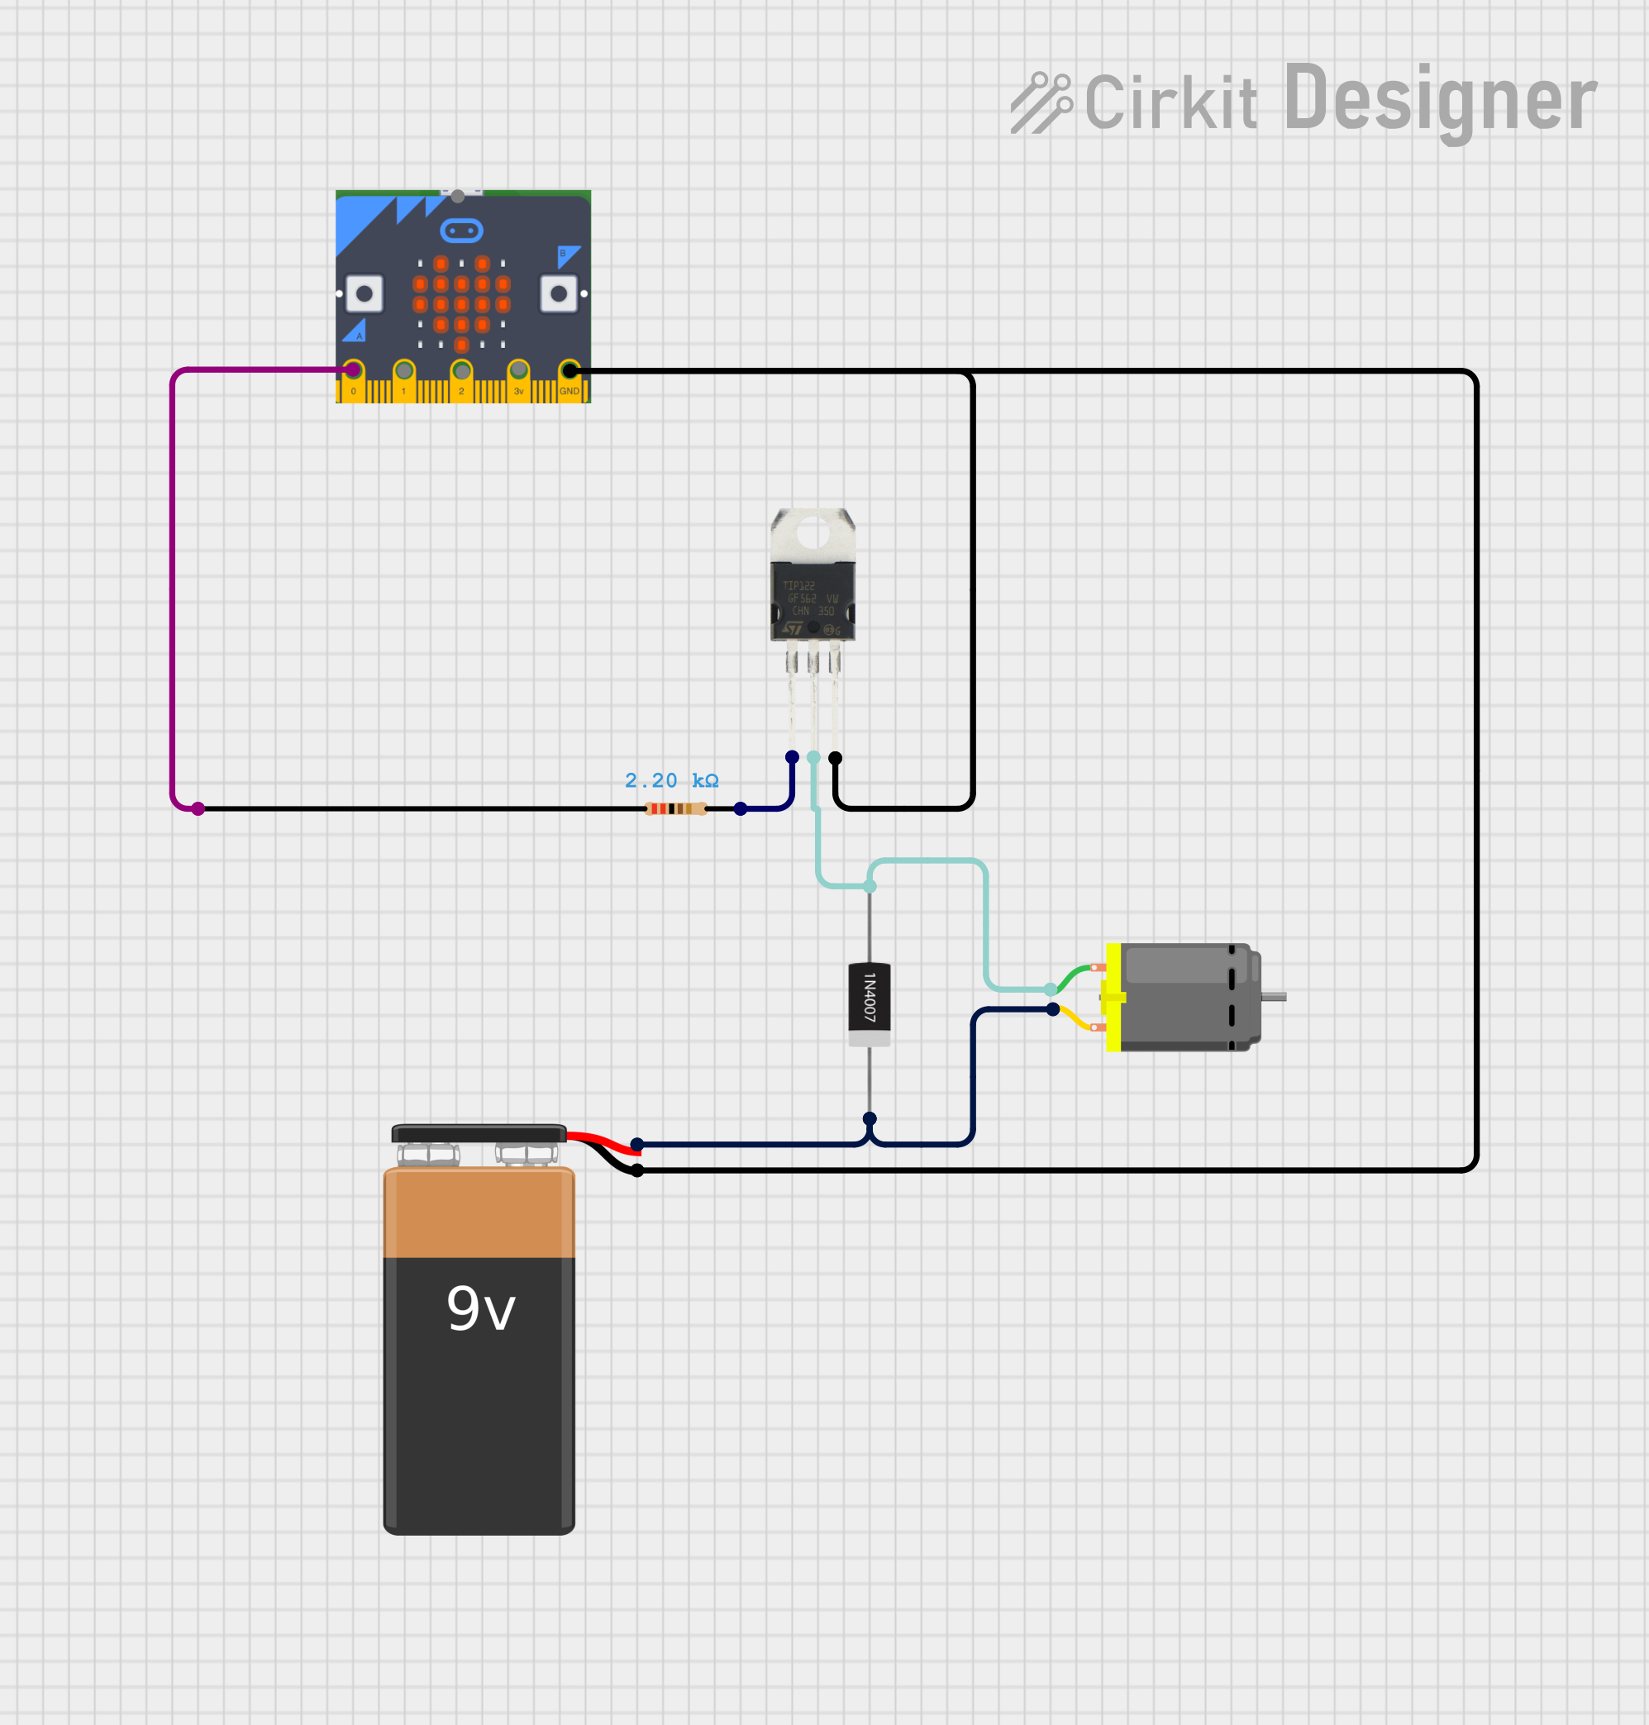
https://app.cirkitdesigner.com/project/d3682d71-2df9-41ce-a4b0-2a48508eead1

Slide 6
from microbit import *
# --- INITIALIZATION ---
# Force Pin 0 to 0 immediately to close the transistor 'gate'
pin0.write_analog(0)
# Ensure the pull-down is set so the pin doesn't 'float'
pin0.set_pull(pin0.PULL_DOWN)
display.clear()
while True:
if button_b.is_pressed():
# --- START MOTOR SEQUENCE ---
count = 0
# Ramp up from 0 to 1023
for speed in range(0, 1024, 41):
# If user lets go during the ramp, jump to the 'else' (stop)
if not button_a.is_pressed():
break
pin0.write_analog(speed)
# LED Progress Bar Logic
y = count // 5
x = count % 5
display.set_pixel(x, y, 9)
count += 1
sleep(40)
# Hold full speed as long as button is held
while button_a.is_pressed():
pin0.write_analog(1023)
else:
# --- IDLE STATE (OFF) ---
# Explicitly write 0 to keep the motor off
pin0.write_analog(0)
display.clear()
# Small sleep to keep the processor from running too hot
sleep(10)

